Slide 1
Specifying and Analyzing Your (Quality) Software Design
Usability Engineering: Process, Products, and Examples
Chapter 13

Slide 2
Specifying and Analyzing Your (Quality) Software Design
Is the design of interaction the only design activity in usability engineering?
The answer is no!

Slide 3
Design of Interface
We have already seen that the design of user interfaces involves
  Design of Interaction.
  Design of the software to run the interaction (Design of Interface).

Slide 4
Specification of Interface
Design of the interface is a software design problem.
It is a difficult software engineering problem.
Notes:
May point out to students that because the design of the interface is intended to support user interactions, we can observe that the design of the software is similar to the design of real-time software.
Concerned with building software that has functional independence, encapsulation and data hiding, reuse PLUS
Concern for the states that the software must be able to support. These points are discussed in later slides.

Slide 5
A Quality Software Specification
A good software specification should have the following minimal characteristics (Fairley, 1985):
  It should be complete.
  It should be correct.
  It should be consistent.
  It should be unambiguous.

Slide 6
Specifying the Requirements for Your Interface Software
What Information Should Be Included?
  The look of the interface and composition of the interface objects.
  Services necessary from other parts of the system.
  The relationships and characteristics of interface objects.
  Sequencing and behavior of interface objects.

Slide 7
Using UML Models to Specify Look and Feel
Models from UML (Universal Modeling Language) can be very useful to specify software requirements for user interfaces.
UML can specify
  Static, structural characteristics of a user interface.
    Classes.
    Relationships between classes.
  Behavioral characteristics of a user interface.
    Activity (workflow) through an interaction.
    States of interaction elements.
Notes:
Note: UML is not specifically intended for usability engineering but can be helpful in puzzling out difficult parts of the requirements..

Slide 8
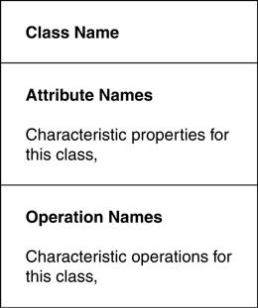
Generic Class Diagram
Notes:
Figure 13.4 - a useful way to organize the information about a class
Top - class name
Middle - class attributes
Bottom - class operations
Attributes are specified one per line in the format:
Name: Type
Operations are specified in the format:
Name(paramater list): return type
Helpful online resources:
http://www.ibm.com/developerworks/rational/library/content/RationalEdge/sep04/bell/

Slide 9
Relationships Between Classes
Association.
Generalization.
Aggregation and composition.
Notes:
Association indicates a relationship between two classes. The relationship is notated at each end of the line. You can also indicate the multiplicity of the relationship. Example: Two classes for an auto rental application: Rental and Vehicle. There is an association between the two classes; a Vehicle can be assigned to a Rental. A Rental may have 0 or 1 (multiplicity) Vehicle assigned to it.
Generalization indicates inheritance.
Aggregation indicates that one class is part of another class. They may exist dependently or independently.
Composition indicates that the aggregation is a dependent one. The child class cannot exist without the parent class.

Slide 10
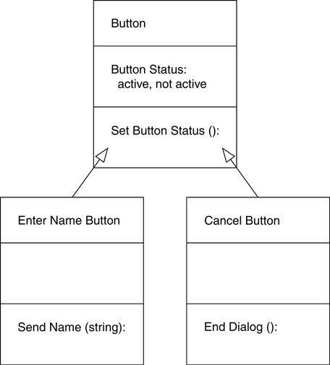
Example
Notes:
Figure 13.5 - This is an example of generalization/inheritance. Button is the parent class and Enter Name Button and Cancel Button inherit the attributes and operations from Button. The two subclasses have additional operations.

Slide 11
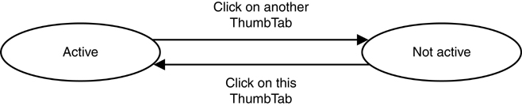
Specifying Behavior Example - Button State
Notes:
Figure 13.13 - state diagrams show the different states that an object can have as events occur.
They should be used when it necessary to keep track of an object used in a variety of circumstances throughout the system.
Here, the ovals indicate the different states that the ThumbTab object can be in. The arrows indicate which actions cause the change of state.
Helpful online resource:
http://atlas.kennesaw.edu/~dbraun/csis4650/A&D/UML_tutorial/state.htm

Slide 12
What is Designed during Software Design?
High-level design
  Major classes and their relationships.
  Messaging or communication architecture.
Low-level design
  Classes (structure and detailed behavior).
  Operations (member functions, class services, or subroutines).
  Attributes (data members).
  Issues of access (e.g., public, private), as well as storage strategies (e.g., static).

Slide 13
Software Design Quality
A software design is of high quality if…
  It is a solution to the problem that was defined in the requirements specification.
  It promotes functional independence.
  It promotes encapsulation and information hiding.
  It promotes software reuse.

Slide 14
Measuring Functional Independence
Qualitative measures of functional independence are:
  Coupling (measure of intermodular dependency)
  Cohesion (measure of internal strength of a module)

Slide 15
Coupling
Low coupling between modules is desirable. High coupling is not as good.
Example of low coupling
  Two modules that communicate by passing parameters.
Example of high coupling
  Module A changes the code within Module B.

Slide 16
Cohesion
High cohesion is good. Low cohesion is bad.
Module A is highly cohesive if all of its elements are focused on a single task.
Module B has low cohesion if several functions are within the same module.
  A module that groups several input functions, just because they involve input, would have relatively low cohesion.

Slide 17
Object-Oriented Coupling and Cohesion?
Page-Jones has noted that coupling and cohesion are defined at the code and subroutine level.
He suggests that it also makes sense to consider class cohesion and class coupling
  Class cohesion level is an indication of how well the operations of the class are focused on one job.
  Class coupling is an indication of how tightly bound two classes are.

Slide 18
Encapsulation
Encapsulation is the grouping of related ideas into one unit which can thereafter be referred to by a single name.
The idea is that the interface is a protective boundary between that which is encapsulated and that which is outside.
  Subroutine is an example of encapsulation
  Classes are a more extreme example of encapsulation.
Encapsulation promotes functional independence.

Slide 19
Information (Data) Hiding
Data hiding is a by-product of encapsulation.
  You may view an encapsulated unit from the inside or the outside.
  Only data needed to perform a function is made available to the function.
  Data hiding is the use of encapsulation to restrict the external visibility of implementation decisions that are internal to the encapsulation structure.
In some regard, encapsulation and data hiding are a way to promote low coupling.

Slide 20
Software Reuse
Software reuse is viewed as essential to improving productivity.
The implication for design is that functionality should be as broad as possible.
Classes may need extra methods to support reuse.
Note that this goal may be in conflict with other software design goals such as loose coupling.

Slide 21
Object-Oriented Philosophy and Design Quality
Object-oriented design should promote:
  Functional independence, at least between classes. The designer is challenged to insure high cohesion and low coupling within the member functions of classes.
  Encapsulation and data hiding.
  Software reuse.

Slide 22
Testing Software
We assess software quality in the same way that we assess the quality of any other software.
Test the software for
  Correct functionality against the specification.
  Correct logical structure.
Tests the software at many levels including
  Module level.
  Functional unit level.
  Whole system level.

Slide 23
UML Exercise
Pick an interaction that you designed in your class project. Specify a class diagram and state diagram for one object in your interaction. If you do not have a class project, select an interaction from the audio catalog.
Notes:
This is Exercise 3 from Chapter 13.

Slide 24
Another UML Exercise
This exercise uses the Map Tool that was presented in the slides for Chapters 11 and 12.
The problem is to build a user interface for a map tool for a cell phone. If you do not have a solution, your teacher will provide one for you to work on.
  Build a class diagram for the Arrow Keys. Show a class for the Arrow Keys and then how this class is a generalization for the Left, Right, Up, and Down Arrow Keys.
  Build a state diagram for the Arrow Keys.

Slide 25
Conclusions
The definition and development of software to support an interaction is itself a software engineering problem.
Like any software engineering problem, the developer must be concerned with specification, design, and testing of the interface.

